Slide 1

Agile Presentation By: Zury Martinez

Slide 2
Agile Roles

Slide 3
Client / Stakeholder
The reason the product is being developed

Slide 4
Product Owner
Liaison between development team and Client / Stakeholder
Manages the product backlog
Involves Client / Stakeholders and end-users in product refinement
The Product Owner ensures the development of products is completed in a timely manner and meets customer satisfaction.

Slide 5
Scrum Master
Coaches team members where needed
Ensures all Scrum events take place
Works with the Product Owner on product backlog
Facilitates team management
The Scrum Master is responsible for establishing Scrum. Scrum Masters are accountable for the development teams’ success as they provide assistance in groups or on a one-to-one basis.

Slide 6
Development Team
Acts as a self-organizing unit
Creates a plan for the sprints
Hold each other accountable
Cross-functional
Instill quality by adhering to the Definition of Done
All team members are on the same level
The Development Team is important in the Agile Methodology as they collaborate to develop a functional product.

Slide 7
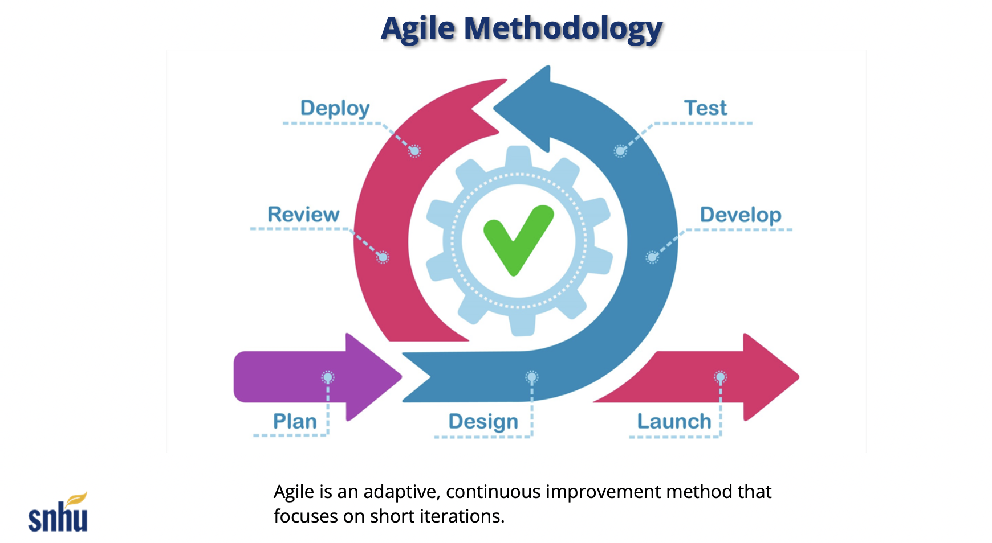
Development Phases of the Software Development Lifecycle (SDLC)

Slide 8
Plan
Collaborate with Clients / Stakeholders
Gather as much information as possible
Discuss requirements

Slide 9
Design, Develop, & Test
Discuss timeline and budget
Define limitations
Breakdown development in smaller increments
Testing is done while developing to ensure functionality
Track, discuss, fix bugs or any other issues

Slide 10
Deploy & Review
Product works as intended
Developers remain at attention for any issues or bugs that may arise

Slide 11
Launch
Product meets Client/ Stakeholder requirements
Product is released to intended user

Slide 12
Had We Used the Waterfall Method Instead…
Had we used the Waterfall Methodology we would have needed to define all the requirements and planned all of it upfront.
Sequential / Linear Stage
Requires majority of the development to be “done” before any feedback is given and testing can begin
Feedback and testing done at the end
Means any changes will be done once testing is completed costing money and time
Waterfall Methodology is one loooooong marathon instead of a series of sprints

Slide 13
Waterfall Example
Given the project discussed in this course, if we would have used the Waterfall Methodology we would have had to have known all the requirements and information in the planning stages.
Communication would be limited
Developing and testing would need to be done before feedback is given limiting flexibility and adaptability
Feedback given would require more planning having the cycle start all over again

Slide 14
Agile Vs Waterfall
Agile
Can begin development with limited information
Can evolve due to adaptability and flexibility
Regular feedback
Customer satisfaction
Circular approach
Waterfall
Requirements must be defined
Best for unchanging products
Limited feedback
Linear or sequential approach

Slide 15
Which approach is right for your product?
When deciding which methodology to use we must consider these points and ask ourselves:
How fast does this product need to be developed?
How likely are features to change mid-way?
Client / Stakeholder availability?
Feature prioritization?

Slide 16
References
CourseaStaff. (2023, November 29). The 3 scrum roles and responsibilities explained. Coursera. https://www.coursera.org/articles/scrum-roles-and-responsibilities
CS250-Module One: SDLC methodologies. (n.d.). http://snhu-media.snhu.edu/files/course_repository/undergraduate/cs/cs250/storyline/mod1/story_html5.html
Davu, S. (2018, November 20). Waterfall vs. agile: Which methodology is right for your project?. Segue Technologies. https://www.seguetech.com/waterfall-vs-agile-methodology/
Hooray, L. (2024, June 1). Agile vs. waterfall: Which project management methodology is best for you?. Forbes. https://www.forbes.com/advisor/business/agile-vs-waterfall-methodology/

